Slide 1

Classification of readmittance rate using Diabetes Dataset
By
Nisah Ahmed
Jiahui Ren
Samson
Rahul

Slide 2
Introduction
10 years of treatment/clinical care data at 130 US Hospitals (from 1999-2008)
Project Statement:
Determine the factors (age, race, gender) and the medications which we can study to reduce the rise of diabetic patients focusing on Readmittance Rate of Patients.
Our aim will be to obtain a higher precision and F1-Score in our confusion matrix on supervised Machine Learning Classifiers.

Slide 3
Hypothesis
Null Hyphothesis - The features do not help us determine the readmittance rate (they are unrelated).
Alternate Hyphothesis - The features help us determine the readmittance rate (they are related).

Slide 4
Data Description
The information has been extracted from the database of patient encounters based on the following criteria:
The patient has been admitted to the hospital.
Diabetes was entered to the system as a diagnosis during the encounter
The length of hospital stay was between 1 to 14 days
Lab tests were carried out during the encounter
Medication was administered during the encounter

Slide 5
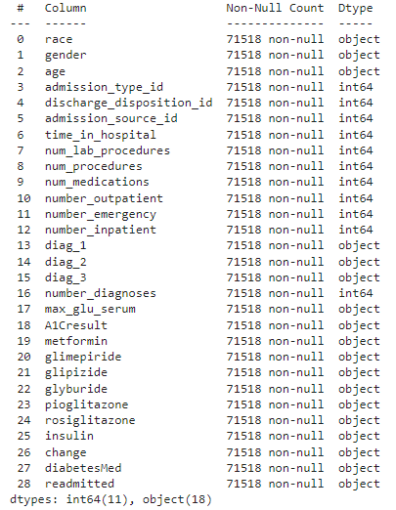
Data Description
Features: 0 to 27
Target/Output: Readmitted (28)

Slide 6
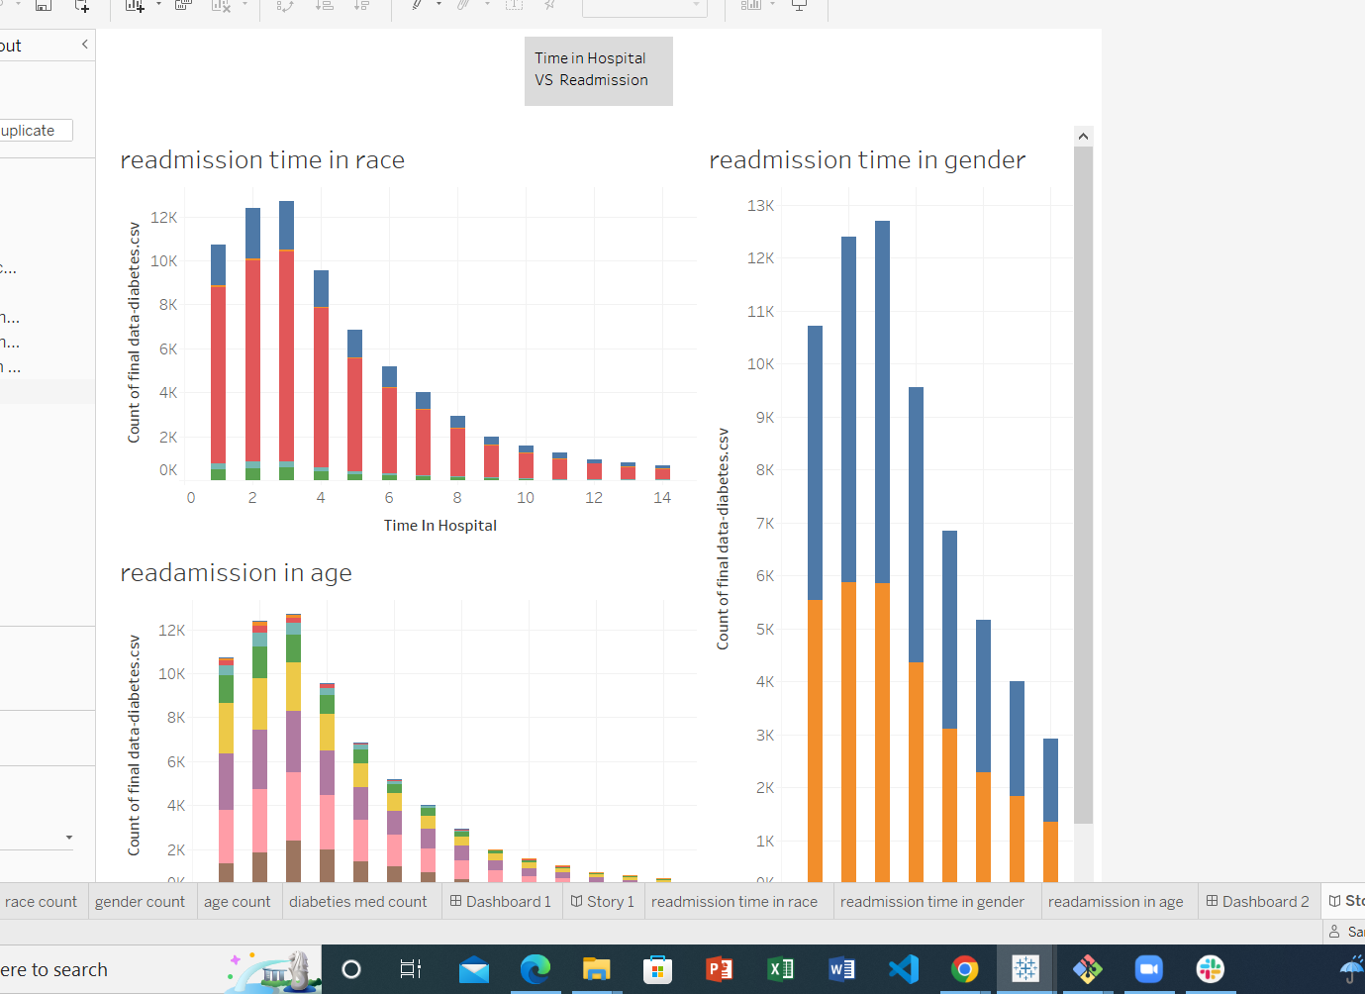
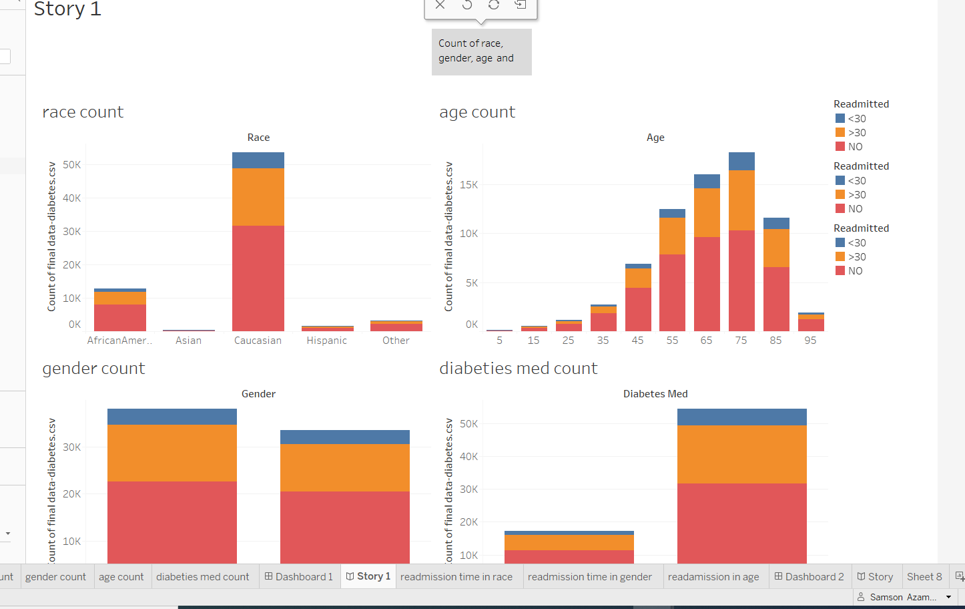
Dashboard

Slide 7
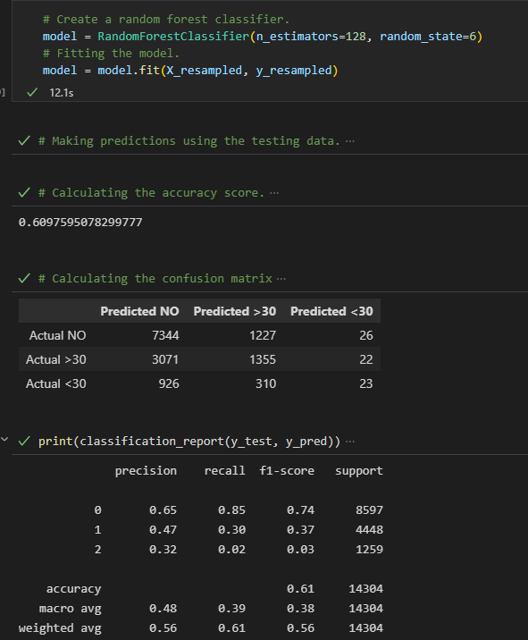
Random Forest Classifier – Attempt 1
Over Sampling and data scaling used.
Total Datapoints – 71518 X 30
The accuracy achieved is 60.98%

Slide 8
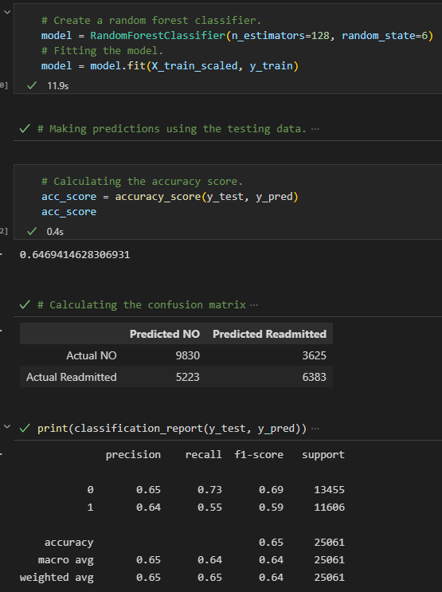
Random Forest Classifier – Attempt 2
The result column was changed from 3 outputs to 2.
Returning patients were not removed as per the initial ETL.
Total Datapoints – 100244 X 30
Accuracy achieved was 64.69%

Slide 9
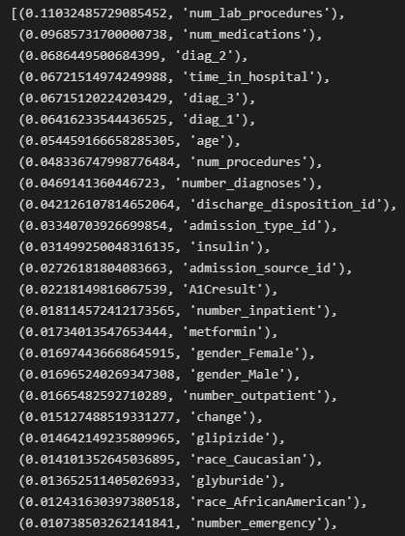
Feature Importance
Usefulness of features in predicting the results - ranked

Slide 10
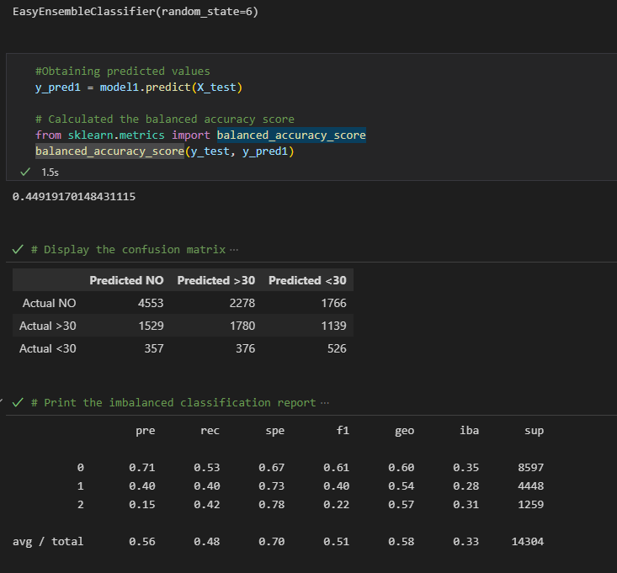
Easy Ensemble Classifier – Attempt 1
Over Sampling and data scaling used.
Total Datapoints – 71518 X 30
Accuracy achieved was 44.92%

Slide 11
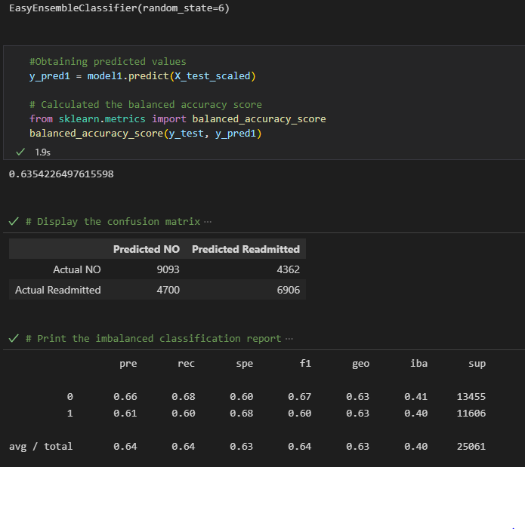
Easy Ensemble Classifier – Attempt 2
The result column was changed from 3 outputs to 2.
Returning patients were not removed as per the initial ETL.
Total Datapoints – 100244 X 30
Accuracy achieved was 63.54%

Slide 12
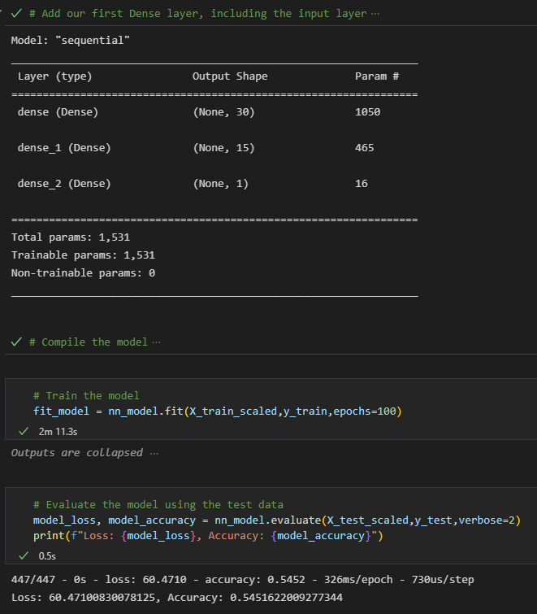
ANN Classifier – Attempt 1
2 layers used
100 epochs
Activation - RELU
Accuracy achieved was 54.52%

Slide 13
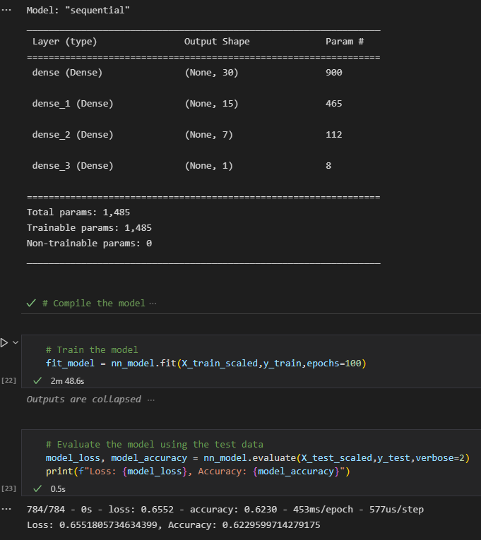
ANN Classifier – Attempt 2
3 layers used
100 epochs
Activation – tanh
The result column was changed from 3 outputs to 2.
Returning patients were not removed as per the initial ETL.
Total Datapoints – 100244 X 30
Accuracy achieved was 62.3%

